Slide 1
Hyperledger

Slide 2
Agenda
HYPERLEDGER
Hyperledger vs bitcoin & Ethereum
Why choose hyperledger?
Hyperledger frameworks
Hyperledger tools
Introducing hyperledger fabric
Consensus and key concepts in Hyperledger Fabric

Slide 3

is an open source collaborative effort created to advance cross-industry blockchain technologies. It is a global collaboration, hosted by The Linux Foundation, including leaders in finance, banking, Internet of Things, supply chains, manufacturing and Technology.

Slide 4
Hyperledger Goals
Create enterprise grade, open source, distributed ledger frameworks and code bases to support business transactions
Provide neutral, open, and community-driven infrastructure supported by technical and business governance
Build technical communities to develop blockchain and shared ledger POCs, use cases, field trails and deployments
Educate the public about the market opportunity for blockchain technology
Promote our community of communities taking a toolkit approach with many platforms and frameworks

Slide 5

Who support Hyperledger?
240+ Organizations supporting Hyperledger

Slide 6
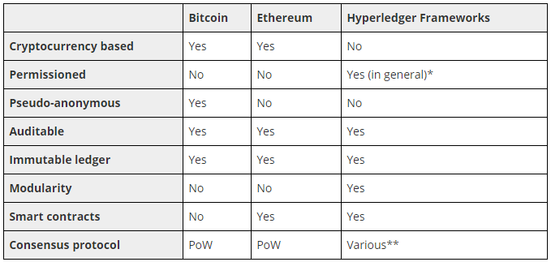
Hyperledger vs Bitcoin & Ethereum
* Sawtooth can be configured to be permissionless
** It depends of the Framework

Slide 7
Why to choose Hyperledger?
Hyperledger is a unique platform that is developing permissioned distributed ledger frameworks specifically designed for enterprises, including those in industries with strong compliance requirements
It can provide “read only” access to regulators.
Open governance.
It has a very mature community of developers.
Is focused on business needs.

Slide 8
Hyperledger Frameworks

Slide 9






Slide 10
Features:
Permissioned and permissionless infrastructure
Modular blockchain architecture
Scalability, which is good for larger blockchain networks due to higher throughput
Many languages for transaction logic
On-chain governance that allows peers to vote on blockchain configuration
An advanced transaction execution engine that can process transactions in parallel to accelerate block creation and validation
Ethereum contract support with Seth, which allows participants to run Solidity smart contracts and integrate with Ethereum tooling
Dynamic consensus lets you upgrade or swap blockchain consensus protocol on the fly as the network grows
Transaction batching

Slide 11
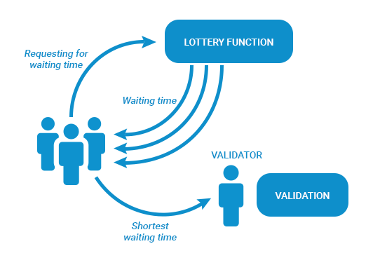
Consensus in Hyperledger Sawtooth
Hyperledger Sawtooth facilitates pluggable consensus for both lottery and voting algorithms. By default, Hyperledger Sawtooth uses a lottery-based, Nakamoto consensus algorithm called PoET. As with Bitcoin’s PoW, PoET uses a lottery for leader election based on a guaranteed wait time provided through a Trusted Execution Environment (TEE)

Slide 12
Features:
Creation and management of custom complex assets, such as currencies or indivisible rights, serial numbers, patents, etc.
Management of user accounts
Taxonomy of accounts based on domains — or sub-ledgers in the system
The system of rights and verification of user permissions for the execution of transactions and queries in the system
Emphasis on mobile application development
Validation of business rules for transactions and queries in the system
YAC consensus algorithm

Slide 13
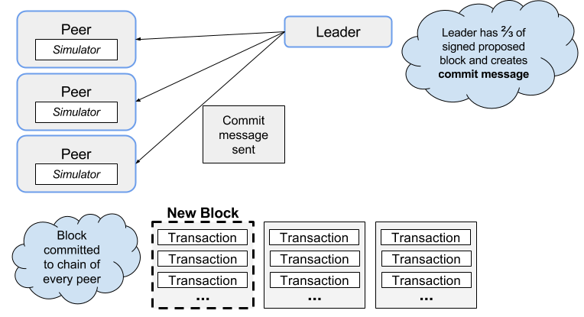
Consensus in Hyperledger Iroha

Slide 14
Features:
Build for decentralized Identity
Allows individuals to manage and control their digital identities. Rather than having businesses store huge amounts of personal data of individuals, Hyperledger Indy allows businesses to store pointers to identity.
RBFT (Redundant Byzantine Fault Tolerance)
It still in incubation state

Slide 15
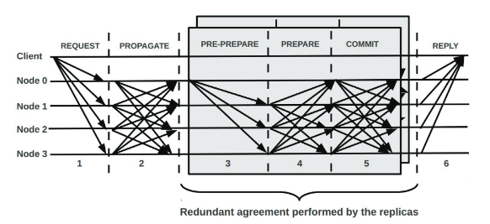
Consensus in Hyperledger Indy

Slide 16
Features:
Hyperledger Burrow provides a modular blockchain client with a permissioned smart contract interpreter partially developed to the specification of the Ethereum Virtual Machine
Permissioned Ethereum Virtual Machine
It still in incubation state

Slide 17
Features:
Allows consensus and membership components to be plug and play
Channels for sharing confidential information
Ordering Service delivers transactions consistently to peers in the network
Endorsement policies for transactions
CouchDB world state supports wide range of queries
Bring-your-own Membership Service Provider (MSP)
It is the most mature project of Hyperledger

Slide 18
Hyperledger Tools

Slide 19



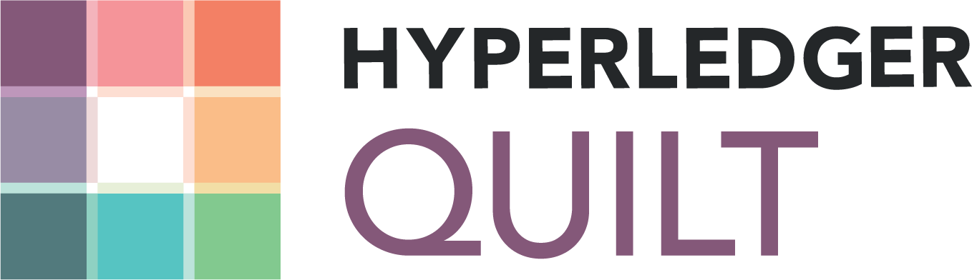
Bring the on-demand “as-a-service” deployment model to the blockchain ecosystem to reduce the effort required for creating, managing and terminating blockchains.
Is a collaboration tool for building blockchain business networks, accelerating the development of smart contracts and their deployment across a distributed ledger.
Can view, invoke, deploy or query blocks, transactions and associated data, network information, chain codes and transaction families, as well as any other relevant information stored in the ledger.
Offers interoperability between ledger systems by implementing ILP, which is primarily a payments protocol and is designed to transfer value across distributed ledgers and non-distributed ledgers.

Slide 20
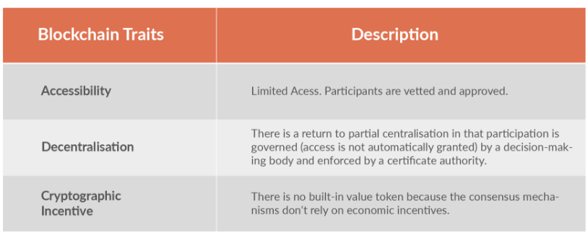
Hyperledger Fabric
Hyperledger Fabric is one of five Hyperledger projects hosted by the Linux Foundation and is the first Hyperledger project in active status. Hyperledger Fabric is a permissioned blockchain platform aimed at business use. It is contributed by IBM and Digital Asset Holdings and provides plug-and-play modular blockchain components.

Slide 21
Client
Clients are the end-user facing nodes. Hyperledger Fabric architecture provides multiple interfaces to the blockchain. These are presented by the client nodes.
SDKs (Software Development Kit)
CLI (Command Line Interface)
Users (which may be application software) send transaction requests to the Hyperledger Fabric network using these interfaces via a client node.

Slide 22
Ordering Service Node
The OS creates new blocks by ordering the transactions. It provides a shared communication channel to clients and peers. It has two services:
Broadcast: to inject messages into the system.
Deliver: for receiving ordered batches

Slide 23
Peers
A blockchain network is primarily comprised of a set of peer nodes. Peers are a fundamental element of the network because they host ledgers and smart contracts.
Peers maintain the state of the ledger. Peers execute chaincode and participate in consensus formation. Chaincode is installed on peers.
A Peer does not create new blocks but it validates blocks and transactions. Transaction validation is performed by simulating transactions and applying the endorsement policy.
It can be:
Validating Peer
Commiting Peer
Anchor Peer

Slide 24
Ledger
The ledger is the sequenced, tamper-resistant record of all state transitions. State transitions are a result of chaincode invocations (“transactions”) submitted by participating parties. Each transaction results in a set of asset key-value pairs that are committed to the ledger as creates, updates, or deletes.
Chain:
The chain is a transaction log, structured as hash-linked blocks, where each block contains a sequence of N transactions.
The chain is stored on the peer file system (either local or attached storage), efficiently supporting the append-only nature of the blockchain workload.
State Database:
The ledger’s current state data represents the latest values for all keys ever included in the chain transaction log. Since current state represents all latest key values known to the channel, it is sometimes referred to as World State.

Slide 25
Identity
The different actors in a blockchain network include peers, orderers, client applications, administrators and more. Each of these actors — active elements inside or outside a network able to consume services — has a digitial identity encapsulated in a certificate.
This identity determine the exact permissions over resources and access to information that actors have in a blockchain network.
For an identity to be verifiable, it must come from a trusted authority. A membership service provider (MSP) is how this is achieved in Fabric. More specifically, an MSP is a component that defines the rules that govern the valid identities for this organization.

Slide 26
Organizations
Blockchain networks are administered by a collection of organizations rather than a single organization.
Peers are central to how this kind of distributed network is built because they are owned by – and are the connection points to the network for – these organizations.
Applications either connect to peers in their organization, or peers in another organization, depending on the nature of the ledger interaction that’s required. For ledger-query interactions, applications typically connect to their own organization’s peers. For ledger-update interactions, we’ll see later why applications need to connect to peers in every organization that is required to endorse the ledger update.

Slide 27
Channels
A Hyperledger Fabric channel is a private “subnet” of communication between two or more specific network members, for the purpose of conducting private and confidential transactions.
A channel is defined by members (organizations), anchor peers per member, the shared ledger, chaincode application(s) and the ordering service node(s). Each transaction on the network is executed on a channel, where each party must be authenticated and authorized to transact on that channel.
Channels doesn’t exist in the same way that peers do – it’s more appropriate to think of a channel as a logical structure that is formed by a collection of physical peers.

Slide 28
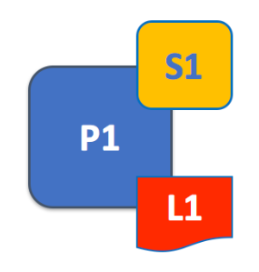
Chaincode
Chaincode is Hyperledger Fabric's implementation of smart contracts.
The most supported high-level language is currently Go.
Chaincode runs in a secured Docker container isolated from the endorsing peer process. Chaincode initializes and manages ledger state through transactions submitted by applications.
A chaincode typically handles business logic agreed to by members of the network, so it similar to a “smart contract”. A chaincode can be invoked to update or query the ledger in a proposal transaction. Given the appropriate permission, a chaincode may invoke another chaincode, either in the same channel or in different channels, to access its state.

Slide 29

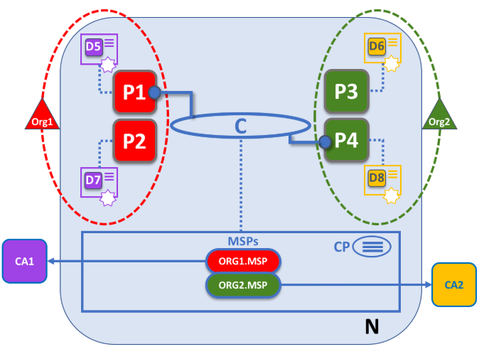

Slide 30
Consensus

Slide 31
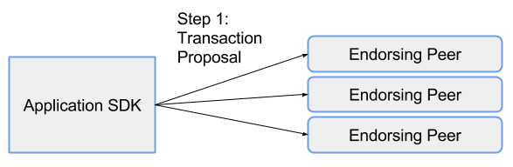
Step 1
Within a Hyperledger Fabric network, transactions start out with client applications sending transaction proposals, or, in other words, proposing a transaction to endorsing peers.

Slide 32
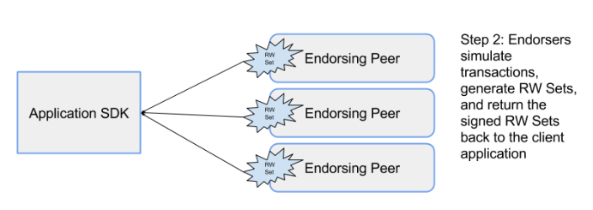
Step 2
Each endorsing peer simulates the proposed transaction, without updating the ledger. This transaction is validated against the Current State and then signed by the endorsing peer, and returned to the client application.

Slide 33
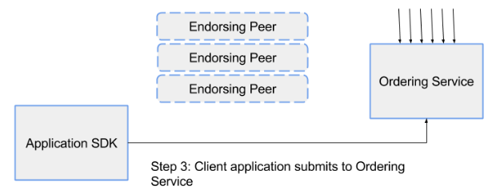
Step 3
The application once they get the enough endorse signatures according to the policy, then submits the endorsed transaction and the result to the ordering service. Ordering happens across the network, in parallel with endorsed transactions from other applications.

Slide 34
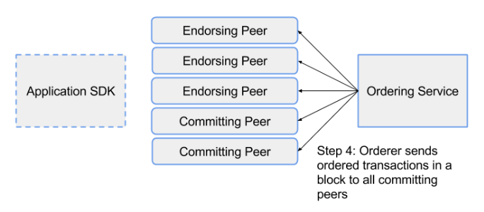
Step 4
The ordering service takes the endorsed transactions and RW sets, orders this information into a block, and delivers the block to all committing peers.

Slide 35
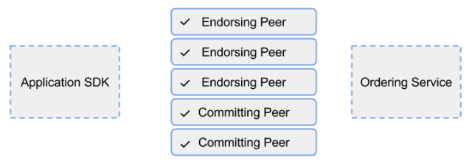
Step 5
The committing peer validates the transaction by checking to make sure that the result of the transaction still match the current world state. When the committing peer validates the transaction, the transaction is written to the ledger, and the world state is updated with the Write data from the RW Set.

Slide 36
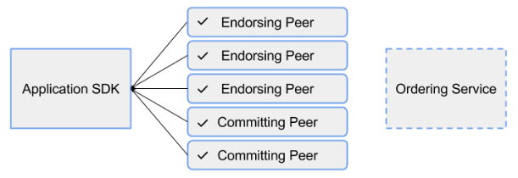
Step 6
Lastly, the committing peers asynchronously notify the client application of the success or failure of the transaction. Applications will be notified by each committing peer.

Slide 37
Comparing Hyperledger consensus algorithms
Consensus algorithm | Approach | Pros | Cons
Kafka (Fabric) | Permissioned voting-based | Provides crash fault tolerance. Finality happens in a matter of seconds. | While Kafka is crash fault tolerant, it is not Byzantine fault tolerant
RBFT (Indy) | Pluggable election strategy set to a permissioned, voting-based strategy by default | Provides Byzantine fault tolerance. Finality happens in a matter of seconds | The more nodes that exist on the network, the more time it takes to reach consensus. The nodes in the network are known and must be totally connected
Sumeragi (Iroha) | Permissioned server reputation system. | Provides Byzantine fault tolerance. Finality happens in a matter of seconds. Scale to petabytes of data, distributed across many clusters | The more nodes that exist on the network, the more time it takes to reach consensus.The nodes in the network are known and must be totally connected.
PoET (Sawtooth) | Pluggable election strategy set to a permissioned, lottery-based strategy by default | Provides scalability and Byzantine fault tolerance | Finality can be delayed due to forks that must be resolved

